Slide 1
Naive Bayes Classifier
Supervised learning
Classification (Predicts Categorical Class Labels )
Application
-Credit Approval
-Medical Diagnosis
-Marketing Targets

Slide 2
Prerequisite
Probability
Dependent & Independent events
Conditional Probability
Bayes Theorem

Slide 3
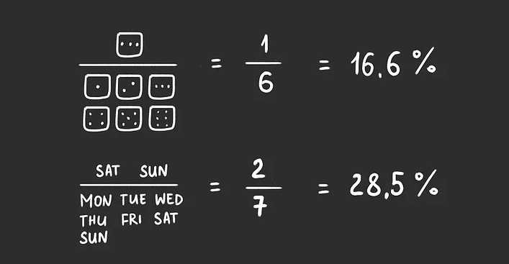
Probability
-Probability is simply how likely something (Event) is to happen.
Probability = Favorable Outcomes
Total Outcomes

Slide 4
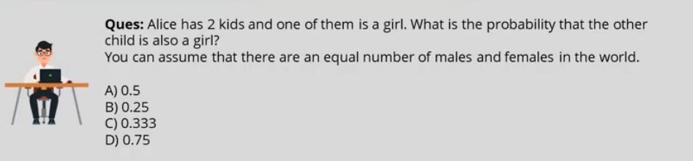
Probability Question

Slide 5
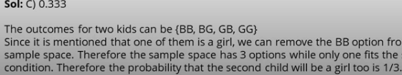
Solution

Slide 6
Independent Event
Two events, A and B, are independent if the fact that A occurs does not affect the probability of B occurring.
Example Tossing Of 2 coins

Slide 7
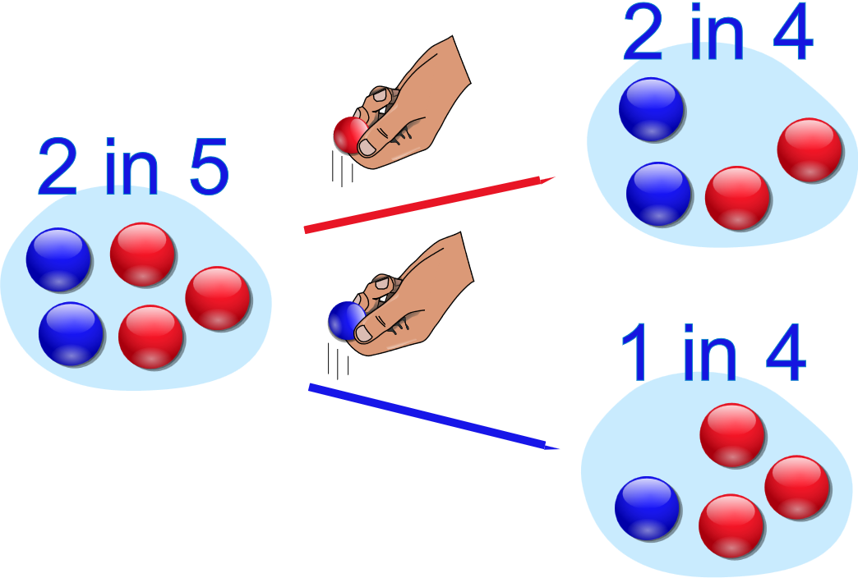
Dependent Events
Two events are dependent if the outcome or occurrence of the first affects the outcome or occurrence of the second so that the probability is changed.

Slide 8
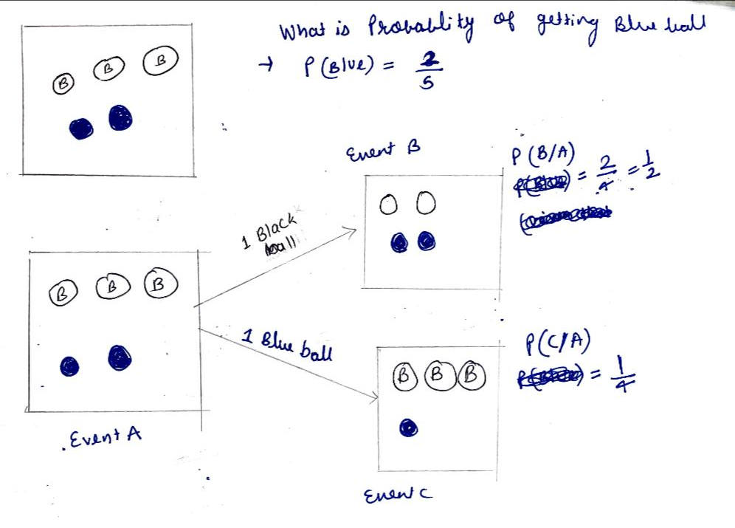
Conditional Probability

Slide 9
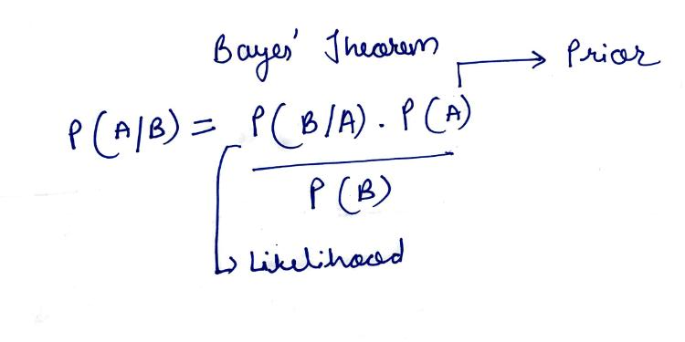
Bayes Theorem

Slide 10
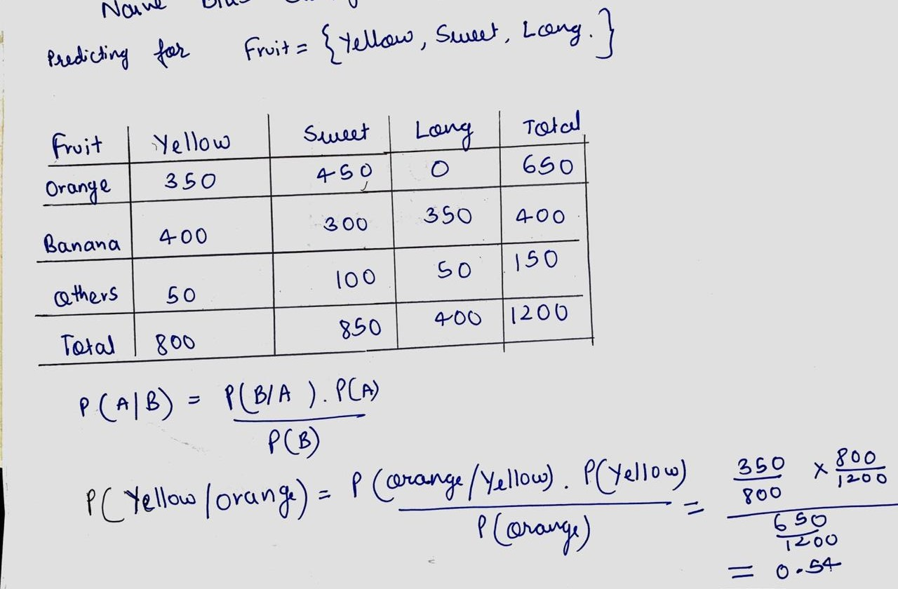
Naïve Bayes Classifier

Slide 11
